Slide 1


Real Estate Price Analysis and Preparation For ML
SIC – AI701
Supervisor: Eng. Aya Nada
Notes:
Note:
1

Slide 2
Agenda
Team Members
Motivation & Problem
Problems in the dataset
Our approach
Cleaning
Transformation
Dashboard
Samsung Innovation Campus

Slide 3




Team Members
Mohamed Younes
Abdallah Elkashef
Kirellos Yousef
Samsung Innovation Campus

Slide 4
Motivation & Problem
Samsung Innovation Campus
Notes:
Note:
2

Slide 5
Motivation & Problem
Motivation
Housing prices are crucial in Mexico City, shaping affordability, investment, and urban planning.
Understanding how location, property type, and size affect prices supports better decisions.
A clean dataset enables reliable ML models for prediction and market insights.
Problem
Raw housing data has missing values, outliers, and inconsistencies.
Without preprocessing, models risk bias and poor accuracy.
Goal: clean, reduce features, and analyze to reveal key drivers of price.
Samsung Innovation Campus

Slide 6
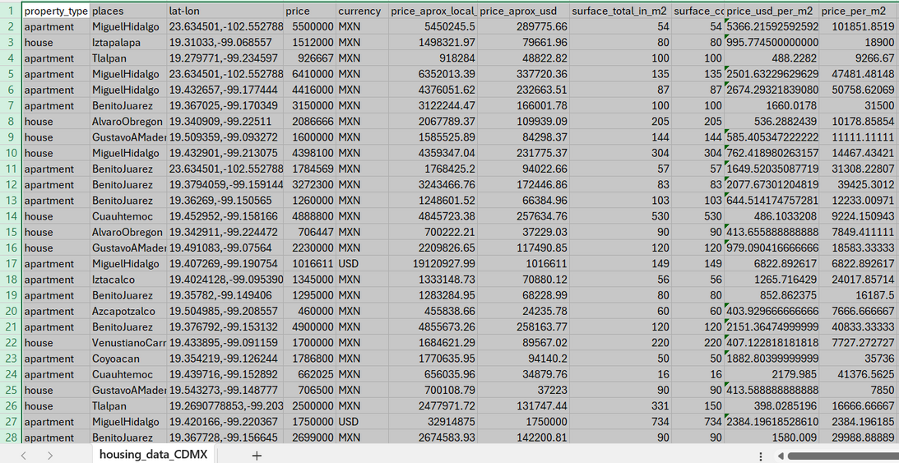
Our DataSet
Samsung Innovation Campus
Notes:
Note:
4

Slide 7
What is our approach
1- Data Cleaning
A- Drop Duplicates, Non-Important Features
B- Feature Engineering
C- Detect And Drop Wrong Data
2- Data Transformation
A- Encoding Categorical Features
B- Scalling Features
3- Dashboard
Samsung Innovation Campus

Slide 8
Data Cleaning
Samsung Innovation Campus
Notes:
Note:
2

Slide 9
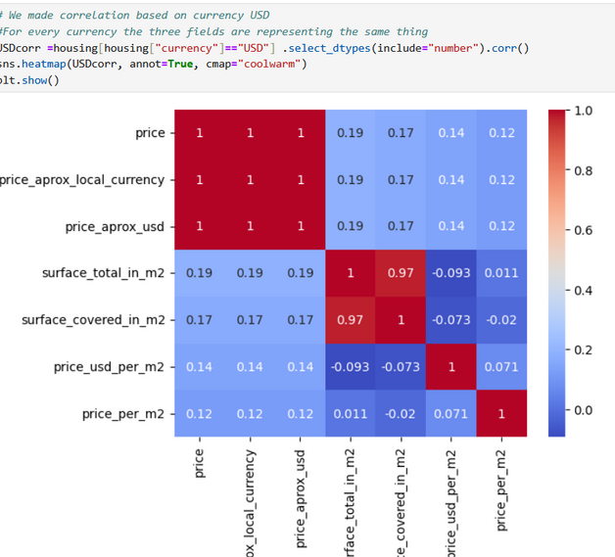
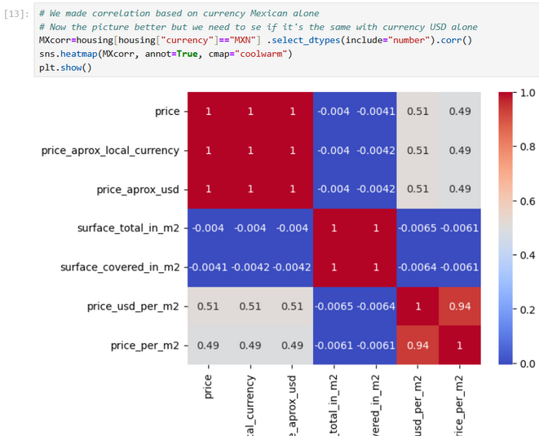
Duplicates & Non-Important Features
Duplicates
We Found 2953 Records and Dropped them
2. Non Important Features
Looking At Corr. Matrix when currency is same We found that correlation is 1 Between Price Fields , so we decided to only use one currency which is USD
Samsung Innovation Campus

Slide 10
Feature Engineering
3. Feature Engineering
First We Extracted Surface Outside from Surface Inside and Surface Total
Then From lat-lon we Extracted longitude and latitude using regex, then made the fields numeric
Samsung Innovation Campus

Slide 11
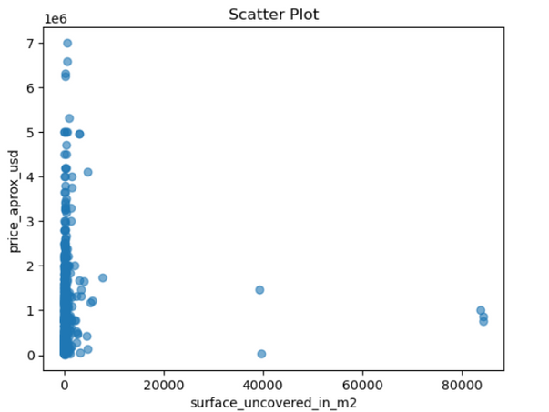
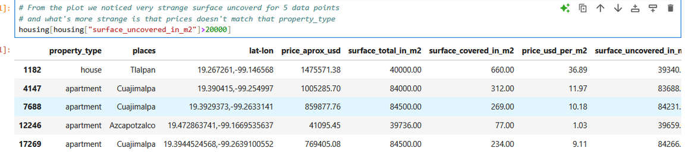
Detect and Drop Wrong Data
1. Space Uncovered
Droped All rows where surface covered is higher than surface total
Also Dropped all abnormal Data
Samsung Innovation Campus

Slide 12
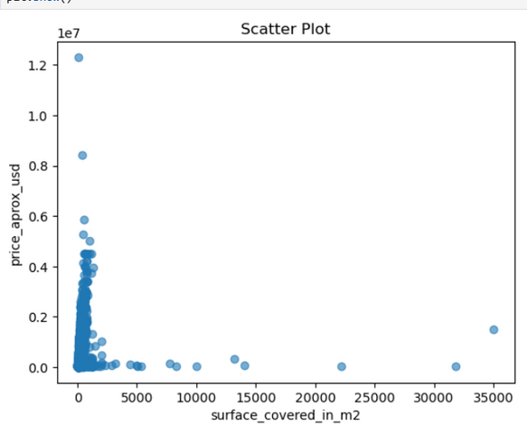
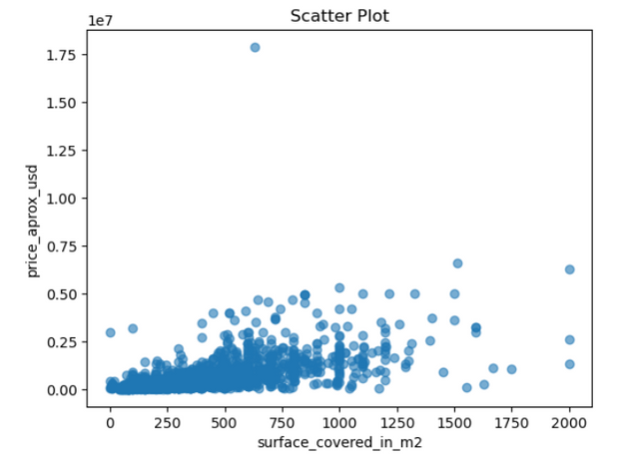
Handle Wrong Data
2. Space Covered
Space covered can’t be more than 2000 m for houses
Before
After
Samsung Innovation Campus

Slide 13
Handle Wrong Data
2. Space Covered
The same process was repeated for the:
Appartment <= 1500 m^2
Store <= 5000
Samsung Innovation Campus

Slide 14
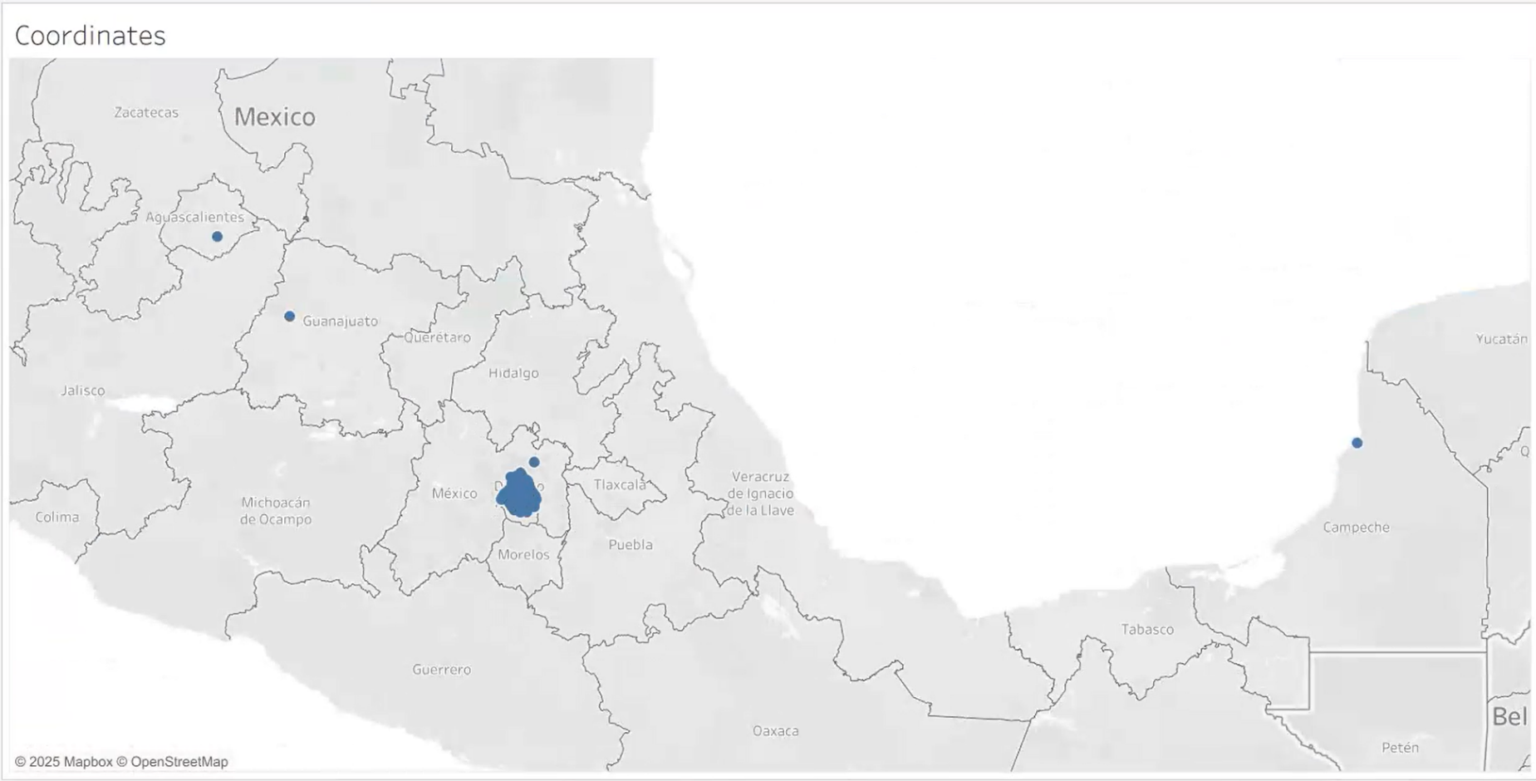
Handle Wrong data
4. Latitude & longitude
Samsung Innovation Campus

Slide 15
Handle Wrong Data
3. Latitude & longitude
We Found some data points outside of Mexico So We removed them By these ranges
Latitude: ~19.0° N to 19.6° N
Longitude: ~-99.0° W to -99.3° W
Samsung Innovation Campus

Slide 16
Data Transformation
Samsung Innovation Campus
Notes:
Note:
2

Slide 17
Encoding Categorical
We turned places and property_type into dummy variables because the categories are nominal
Samsung Innovation Campus

Slide 18
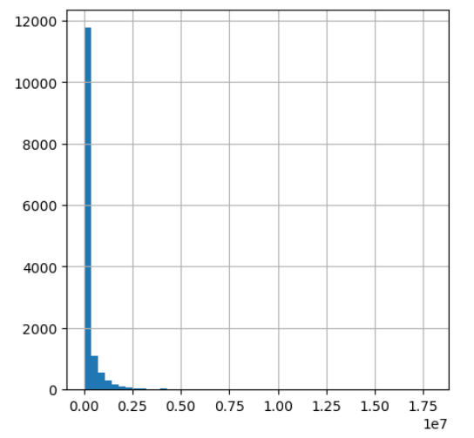
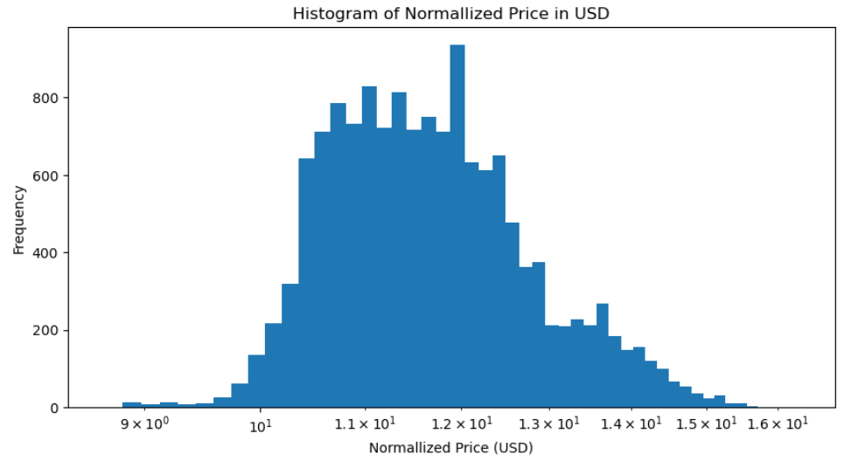
Scalling
First, we used Log-transformation to compress extreme outliers
Before
After
Samsung Innovation Campus

Slide 19
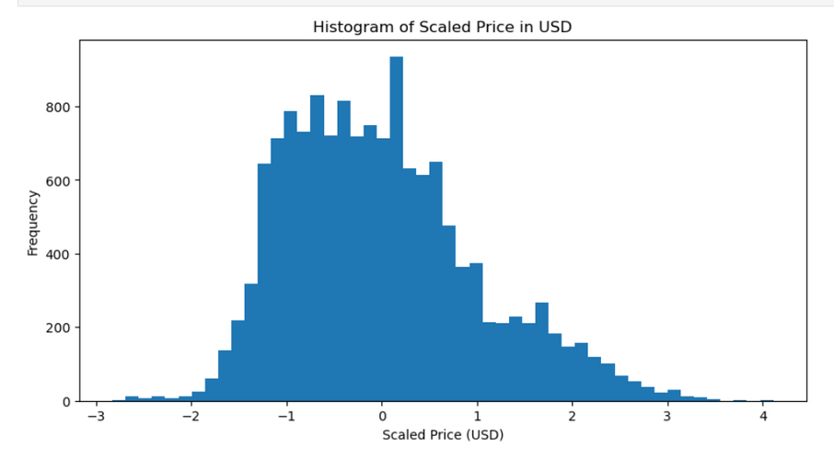
Scalling
If Bell-shaped we use Standardization because it’s usually better
If not, we use normalization or Robust Scaller
Samsung Innovation Campus

Slide 20
Dashboard
Samsung Innovation Campus
Notes:
Note:
2

Slide 21


Slide 22

ⓒ2020 SAMSUNG. All rights reserved.
Samsung Electronics Corporate Citizenship Office holds the copyright of book.
This book is a literary property protected by copyright law so reprint and reproduction without permission are prohibited.
To use this book other than the curriculum of Samsung innovation Campus or to use the entire or part of this book, you must receive written consent from copyright holder.
Notes:
14

